Slide 1
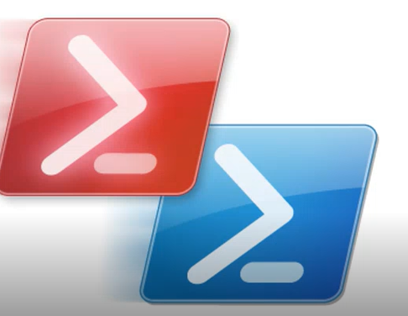
Windows Powershell
Powershell in Automation

Slide 2
Introduction
windows powershell is a Command line language which basically reuses .net framework.
When it comes to windows oS,its totally built out of .net
Powershell has tight integration with different platforms can be used in Cloud azure,aws windows machines,Vmware,SCCM,AD etc.
Mostly used by systemadmin to automate routine daily tasks,like generating reports for CPU memrory,getting service status,installing applications,getting server uptime,migrations etc
Latest version:
v5.1(part of windows management framework 5.1)
Powershell 7(Powershell –core,Cross-platform)
Interactive Mode and Scripting Mode(ISE)
7. Which is object based approach and operates on .net,WMI,COM Objects

Slide 3
Powershell Host
1. Console Host
2. ISE Host
$Host
$psversiontable.PSVersion.Major

Slide 4
Execution Policy
The execution policy is part of the security strategy of Windows PowerShell.
Restricted - No scripts can be run. Windows PowerShell can be used only in interactive mode.
AllSigned - Requires that all scripts and configuration files be signed by a trusted publisher, including scripts that you write on the local computer.
RemoteSigned - Scripts which are required to run remotely needs digital signature but for the scripts which runs on local machine not required
Unrestricted - No restrictions; all Windows PowerShell scripts can be run.
Bypass : Nothing is blocked and there are no warnings or prompts ,so its just by pass execution
Default : Sets default policy as Restricted for Windows clients., RemoteSigned for Windows servers.

Slide 5
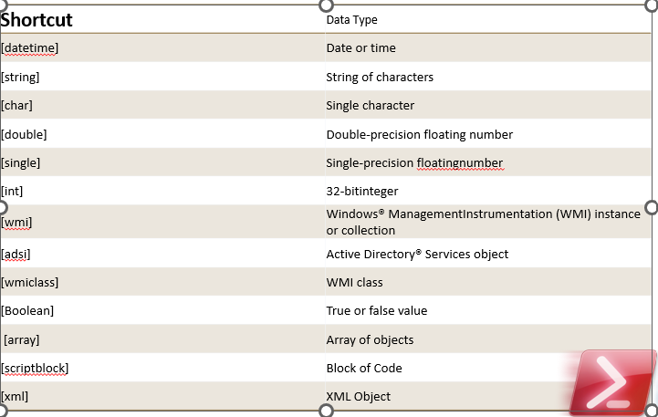
Variables and Datatypes
Variables are data holding elements

